Slide 1
Statistics: Collecting Data
EQ: What is a frequency table and how do I use one?

Slide 2
First 5

Slide 3
24
7
30
Topic: Collecting data
EQ: What is a frequency table and how do I use one?
What is Data?
Data can be any sort of information that can be recorded or analysed. It comes in different forms:
Primary – data you collect yourself
Secondary – data obtained from another source e.g. the internet
Categorical – information about categories e.g. eye colours in students
Numerical – data values are numbers
WICOR

Slide 4
24
7
30
Topic: Collecting data
EQ: What is a frequency table and how do I use one?
What are the two types of numerical data?
Numerical data can be described in two ways:
Discrete data is data that can only have particular values, in most case whole numbers. E.g. runs scored in a cricket match
Continuous data is data that is measured and can be any number. E.g. the weights of yr 7 students.
WICOR

Slide 5
LHS Practise
Write down whether the following are discrete or continuous:
Goals scored at a football match
Number of siblings each student in a class has
Heights of students in a Yr 7 class
Shoe sizes of a Yr 7 class
The time it takes students to run 100m

Slide 6
LHS Practise
Write down whether the following are discrete or continuous:
Goals scored at a football match - Discrete
Number of siblings each student in a class has - Discrete
Heights of students in a Yr 7 class - Continuous
Shoe sizes of a Yr 7 class - Discrete
The time it takes students to run 100m - Continuous

Slide 7
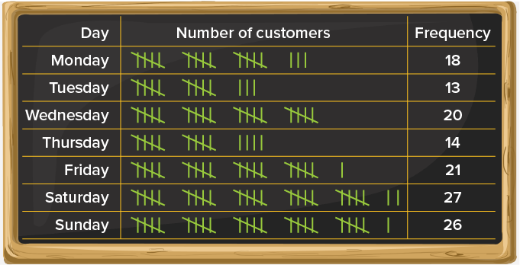
24
7
30
Topic: Collecting data
EQ: What is a frequency table and how do I use one?
What is a frequency table?
Any data that has repeated values can be organized in a frequency table. In a frequency table, each data value is listed. Every time that value occurs, it is recorded in the “tally” column. The tally can then be counted at the end and a number put into the “frequency” column.
WICOR

Slide 8
24
7
30
Topic: Collecting data
EQ: What is a frequency table and how do I use one?
What are the steps to making a frequency table?
Gather your data
Draw up a table with 3 columns that shows the item being surveyed, the tally and the frequency
Enter the data into the tally column
Enter these tallies as numbers in the frequency column. Add up all the numbers in this column to make sure that you have tallied correctly!
WICOR

Slide 9
Class example!
Lets create a frequency table to look at the number of siblings for this class!
Please wait until the teacher gives you the instruction to share your information so that they can be accurately counted and put into the table.
Copy the tally into your own table!
Number of siblings | Tally | Frequency
0
1
2
3
4
5
 | Total

Slide 10
What happens if we have a large set of data?
The Wildcats basketball team has kept a record of their points scored last season. These are:
73, 84, 68, 45, 52, 44, 45, 52, 66, 42, 43, 53, 47, 82, 76, 42, 57, 65, 81, 80, 40, 56, 72, 74, 83, 41, 66, 76, 75, 68, 81, 82, 79, 58, 81, 78, 80, 78, 76.
Is this data discrete or continuous?
What problems might you have putting this information on a frequency table similar to the one we just completed?

Slide 11
24
7
30
Topic: Collecting data
EQ: What is a frequency table and how do I use one?
How can I sort large amounts of data easier?
When there is a large amount of numerical data spread out over many values, we group the data into sets called “classes”.
This means that we group the data into an interval of 5 or 10 so that you get smaller groups for your table. These are called “class intervals” and go into the first column of your frequency table.
Note: you need to make sure that your intervals are all the same size
e.g. intervals 0-9, 10-19, 20-29 etc.
WICOR

Slide 12
24
7
30
Topic: Collecting data
EQ: What is a frequency table and how do I use one?
How do we create a grouped frequency table?
1. Determine the smallest and biggest values, this will tell you the range of your data.
2. Decide on how you are going to group your data.
3. Draw your table with 3 columns.
73, 84, 68, 45, 52, 44, 45, 52, 66, 42, 43, 53, 47, 82, 56, 72, 74, 81, 41, 66, 76, 75, 68, 81, 82, 79, 58, 81, 78, 76.
Our smallest value is 41, largest is 84
84 - 41 = 43
We could split it into intervals of 9
e.g. 40 – 49, 50 - 59

Slide 13
24
7
30
Topic: Collecting data
EQ: What is a frequency table and how do I use one?
How do we create a grouped frequency table?
3. Draw your table with 3 columns.
Be careful with your intervals so that you don’t miss numbers or have them twice!
73, 84, 68, 45, 52, 44, 45, 52, 66, 42, 43, 53, 47, 82, 56, 72, 74, 81, 41, 66, 76, 75, 68, 81, 82, 79, 58, 81, 78, 76.
Number of goals | Tally | Frequency
40 – 49
50 – 59
60 – 69
70 – 79
80 - 89
 | Total | 30

Slide 14
24
7
30
Topic: Collecting data
EQ: What is a frequency table and how do I use one?
How do we create a grouped frequency table?
4. Use the tally column to help with the count (work left to right)
5. Enter the tallies as numbers and add them all up to check that you have the correct total
73, 84, 68, 45, 52, 44, 45, 52, 66, 42, 43, 53, 47, 82, 56, 72, 74, 81, 41, 66, 76, 75, 68, 81, 82, 79, 58, 81, 78, 76.
Number of goals | Tally | Frequency
40 – 49 | IIIII II | 7
50 – 59 | IIIII | 5
60 – 69 | IIII | 4
70 – 79 | IIIII III | 8
80 - 89 | IIIII I | 6
 | Total | 30

Slide 15
Your turn! LHS
Put the following sets of data into frequency tables
Number of pets students have:
{ 2, 3, 5, 0, 1, 0, 1, 2, 3, 4, 0, 1, 1, 2, 6, 2, 0, 1, 2 }
Height of Yr 8 students:
{ 145, 140, 160, 135, 135, 145, 143, 162, 145, 135, 150, 145, 140, 140, 145, 125, 140, 141, 150, 152, 155, 140, 145, 135, 135 }

